Slide 1
Application of a Structural Equation Model to Data from the Midlife in the United States Study (MIDUS)

Slide 2
Project Aim
To understand the effect of personality types on negative affect
Dependent variable: negative affect
Independent variable: personality

Slide 3
Background
Personality and negative affect are latent variables, which are constructs that can’t be directly measured
We try to obtain a measure of the “true score” on the latent variable by collecting observed indicators of the construct
For example, the following observed indicators (items) were collected to obtain a measure of the true score for negative affect:
During the past 30 days, how much of the time did you feel
So sad nothing could cheer you up
Nervous
Restless or fidgety
Hopeless
That everything was an effort
Worthless

Slide 4
Negative Affect Data
Data come from the Midlife in the United States Study (Ryff et al., 2007)
The negative affect scale used consists of 6 Likert-type items with response options ranging from 1-5
The reliability (greatest lower bound) for this scale was 0.89 (McNeish, 2018; Trizano-Hermosilla & Alvarado, 2016)

Slide 5
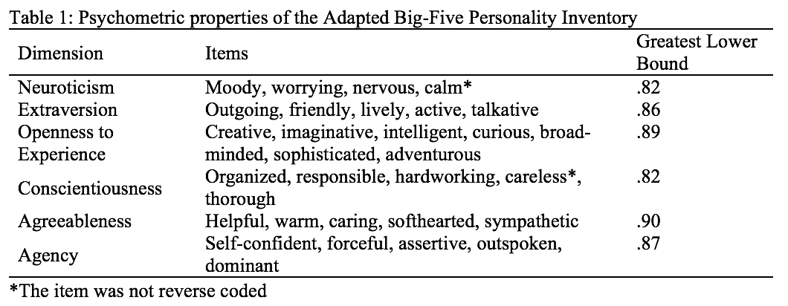
Personality Data
Data come from the Midlife in the United States Study (Ryff et al., 2007)
The Adapted Big-five Personality Inventory was used to assess six latent dimensions of personality (neuroticism, extraversion, openness to experience, conscientiousness, agreeableness agency) using 31 Likert-type items with response options ranging from 1-4
See Table 1 for the reliability (greatest lower bound) of this scale (McNeish, 2018; Trizano-Hermosilla & Alvarado, 2016)

Slide 6
Analysis
Confirmatory factor analysis (CFA) estimates the true score on a latent variable based on the relationships among the observed indicators
A structural equation model was used to relate the CFA of personality to the CFA of negative affect

Slide 7
Categorical Data Handling
The 31 personality items were treated as categorical since there are only 4 response options
The 6 negative affect items were treated as continuous since there are more than 5 response options
Justification: Johnson & Creech (1983)

Slide 8
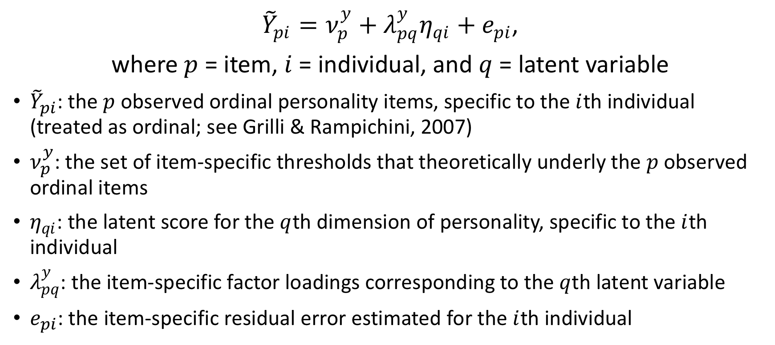
The CFA for Personality
${\tilde{Y}}_{pi}=ν_{p}^{y}+λ_{pq}^{y}η_{qi}+e_{pi}$,
where $p$ = item, $i$ = individual, and $q$ = latent variable
${\tilde{Y}}_{pi}$: the $p$observed ordinal personality items, specific to the $i$th individual (treated as ordinal; see Grilli & Rampichini, 2007)
$ν_{p}^{y}$: the set of item-specific thresholds that theoretically underly the $p$observed ordinal items
$η_{qi}$: the latent score for the $q$th dimension of personality, specific to the $i$th individual
$λ_{pq}^{y}$: the item-specific factor loadings corresponding to the $q$th latent variable
$e_{pi}$: the item-specific residual error estimated for the $i$th individual

Slide 9
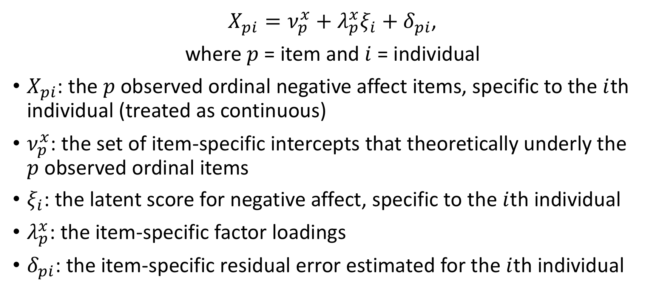
The CFA for Negative Affect
$X_{pi}=ν_{p}^{x}+λ_{p}^{x}ξ_{i}+δ_{pi}$,
where $p$ = item and $i$ = individual
$X_{pi}$: the $p$observed ordinal negative affect items, specific to the $i$th individual (treated as continuous)
$ν_{p}^{x}$: the set of item-specific intercepts that theoretically underly the $p$observed ordinal items
$ξ_{i}$: the latent score for negative affect, specific to the $i$th individual
$λ_{p}^{x}$: the item-specific factor loadings
$δ_{pi}$: the item-specific residual error estimated for the $i$th individual

Slide 10
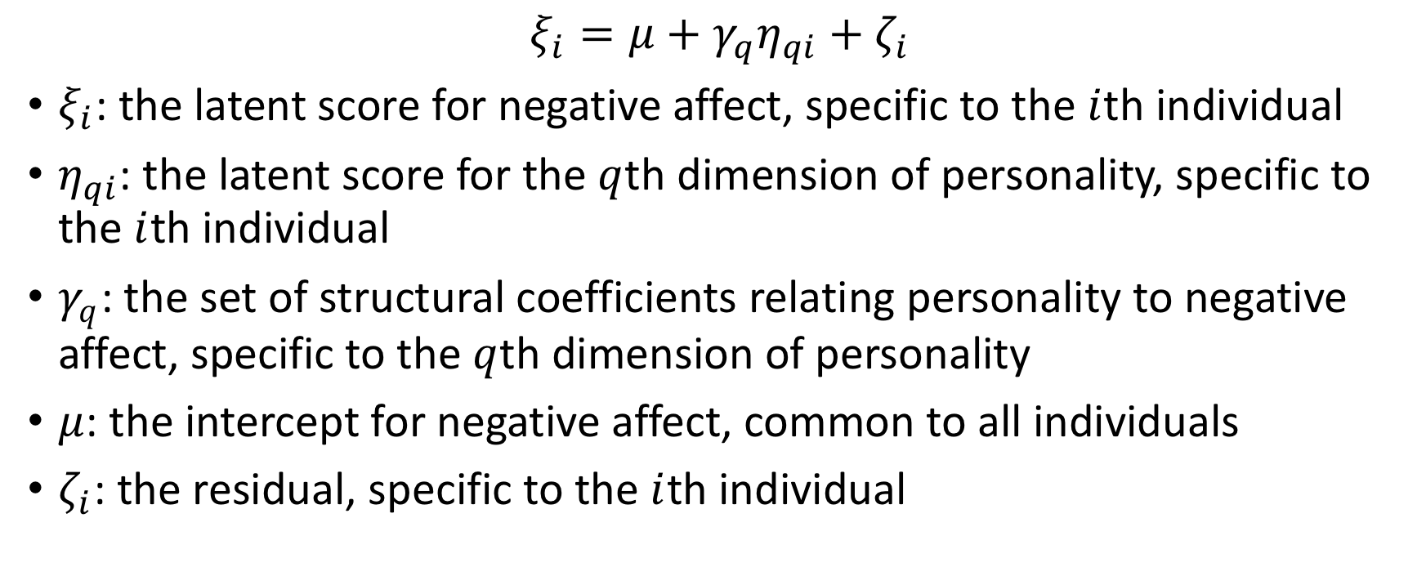
The Structural Equation Model Relating the Two CFA Models
$$ξ_{i}=μ+γ_{q}η_{qi}+ζ_{i}$$
$ξ_{i}$: the latent score for negative affect, specific to the $i$th individual
$η_{qi}$: the latent score for the $q$th dimension of personality, specific to the $i$th individual
$γ_{q}$: the set of structural coefficients relating personality to negative affect, specific to the $q$th dimension of personality
$μ$: the intercept for negative affect, common to all individuals
$ζ_{i}$: the residual, specific to the $i$th individual

Slide 11
Estimation
Parameter estimates were obtained using Bayesian estimation with two MCMC chains for faster computation
Non-informative priors were specified so that the Bayesian estimates would be similar to what would have been obtained with maximum likelihood had maximum likelihood been feasible
Maximum likelihood was not feasible due to the immense computational demand of producing estimates for categorical outcome variables and a large number of latent variables

Slide 12
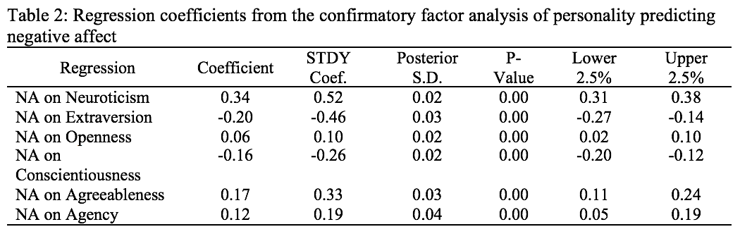
Results
A one-unit increase in neuroticism corresponds to a statistically significant 0.34 unit increase in negative affect, ceteris paribus (p < .0001)
A one-unit increase in extraversion corresponds to a statistically significant 0.20 unit decrease in negative affect, ceteris paribus (p < .0001)
A one-unit increase in openness corresponds to a statistically significant 0.06 unit increase in negative affect, ceteris paribus (p < .0001)
A one-unit increase in conscientiousness corresponds to a statistically significant 0.16 unit decrease in negative affect, ceteris paribus (p < .0001)
A one-unit increase in agreeableness corresponds to a statistically significant 0.17 unit increase in negative affect, ceteris paribus (p < .0001)
A one-unit increase in agency corresponds to a statistically significant 0.12 unit increase in negative affect, ceteris paribus (p < .0001)

Slide 13
Software
R was used to calculate reliability for the personality and affect scales
Mplus version 8.3 was used to fit the Bayesian structural equation models

Slide 14
References
Johnson, D. R., & Creech, J. C. (1983). Ordinal measures in multiple indicator models: A simulation study of categorization error. American Sociological Review, 398-407.
Leonardo Grilli & Carla Rampichini (2007) Multilevel Factor Models for Ordinal Variables, Structural Equation Modeling, 14:1, 1-25.
McNeish, D. (2018). Thanks coefficient alpha, we’ll take it from here. Psychological Methods, 23(3), 412-433.
Ryff, C., Almeida, D. M., Ayanian, J. S., Carr, D. S., Cleary, P. D., Coe, C., ... & Mroczek, D. K. (2007). National survey of midlife development in the United States (MIDUS II), 2004-2006.
Trizano-Hermosilla, I., & Alvarado, J. M. (2016). Best alternatives to Cronbach's alpha reliability in realistic conditions: congeneric and asymmetrical measurements. Frontiers in psychology, 7, 769.

